Slide 1

Code Clone Research Overview
Tianyu Wang
October 8,2021

Slide 2

Backgrounds
Focus on Self Admitted Technical Debts(SATDs) in code clones
Self Admitted Technical Debts
Technical debt refers to the phenomena of taking shortcuts to achieve short term gain at the cost of higher maintenance efforts in the future.
Authors may be aware of technical debts and write them down in code comments, this is so called “Self-Admitted Technical Debt”.
Code Clone
In a software system, similar or identical fragments of code are known as code clones.
The main reason behind difficulty in software maintenance is code clones.

Slide 3
RQs
Identify self-admitted technical debts, using the NLP approach from prior work. Once we identify the self-admitted technical debts, we would answer the following research questions.
RQ1：How many self-admitted technical debts get removed?
RQ2：Who removes self-admitted technical debts?
RQ3：How long do self-admitted technical debts survive in a project?

Slide 4
Code Clone in 33 Projects
518,270 pairs of code clone in total
Clone pair | Start commit
filepath1^start^end+filepath2^start^end | Commit id

Slide 5
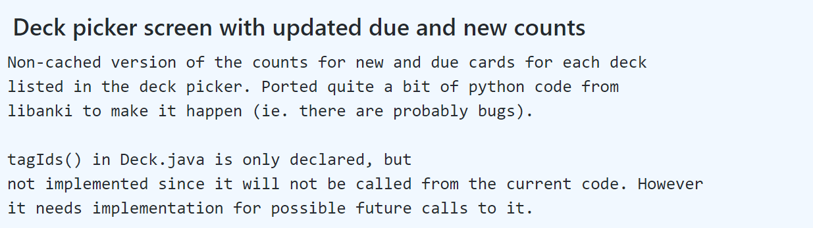
Commit Message Collection
22,570 commits in total
2 parts of commit messages were collected(title and body)using the commands below
Commit title
Commit body
git log --pretty=format:”%s” SHA -1
git log --pretty=format:”%b” SHA -1

Slide 6
Code Comment Collection
17,729 code comments in total (unique)
Use regular expression to get single line comments and multi line comments in code clone.
Code comments before the starting line are also collected if the code block is incomplete.
If @Test is in the code clone, all code comments will be deleted.
/*
Code comment
*/
public class Test {
Start line
End line
}
{
// Code comment
Start line
End line
}
@Test
public class Test {
Start line
End line
}
Status:
3% clone pairs report error(some of the files may be renamed or remove)

Slide 7
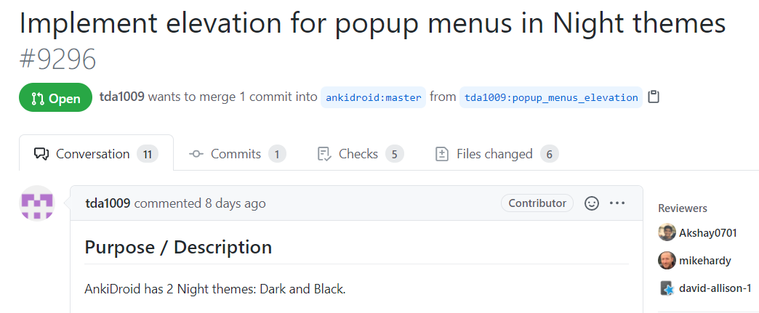
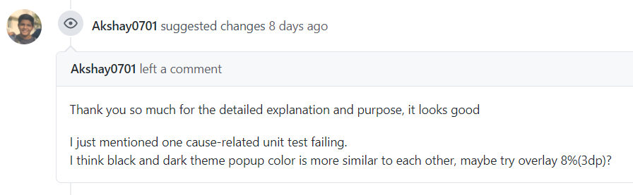
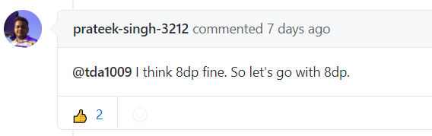
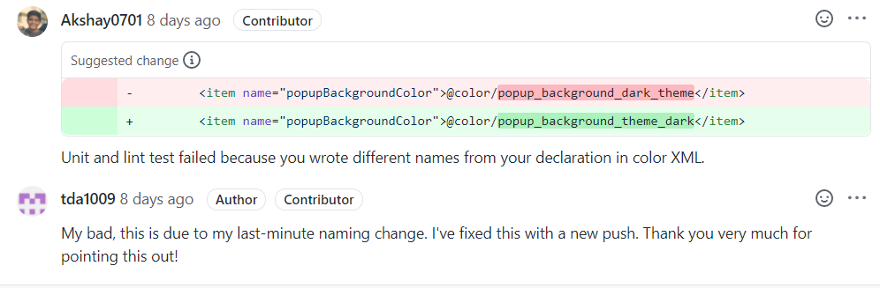
Pull Request Collection (related to code clone)
8,148 pull requests in total
Conversations in PR
Reviews(21,999)
title
body
review comments(60,130)
Issue comments(23,614)

Slide 8
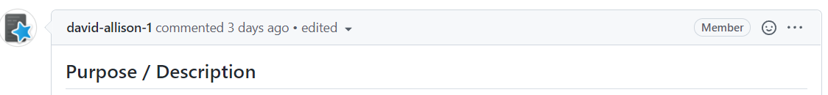
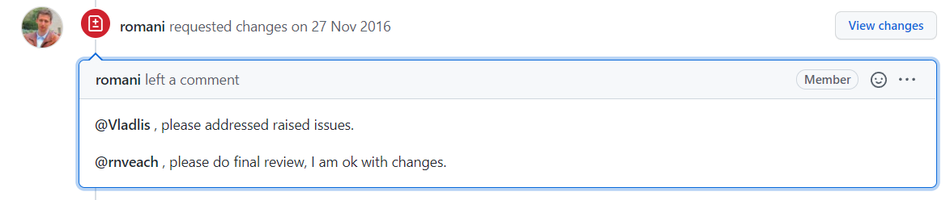
Author and date of each message
Author association
State of reviews (APPROVED, CHANGES_REQUESTED, COMMENTED, DISMISSED)
Reactions

Slide 9
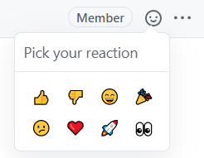
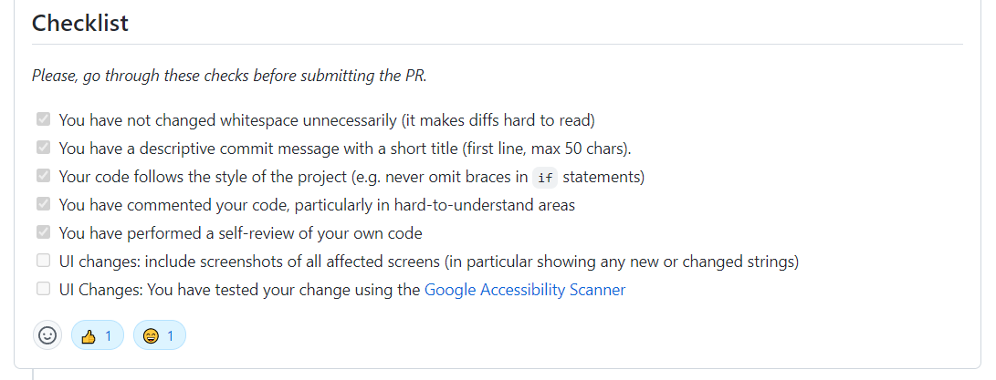
Reactions

Slide 10
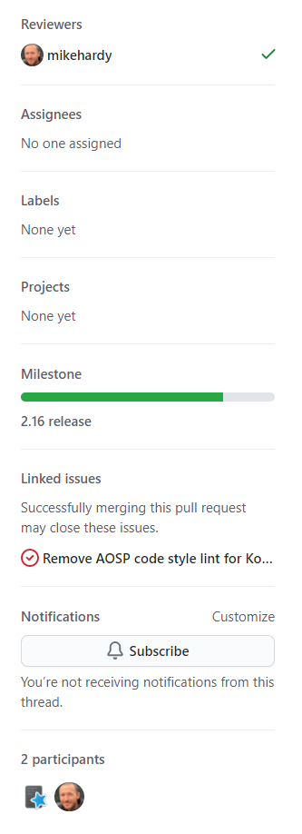
Basic information of pull request:
Author
Creation date
Update date
Merge date
Closing date
Assignees
Labels
Projects
Milestone
Title
Description
Creator
Created at
State
……

Slide 11



Events in pull request
Issues event
Timeline event
Each event has its unique attributes
More details can be found in
https://docs.github.com/
assigned
automatic_base_change_failed
automatic_base_change_succeeded
base_ref_changed
closed
commented
committed
connected
convert_to_draft
converted_note_to_issue
cross-referenced
demilestoned
deployed
deployment_environment_changed
Disconnected
……

Slide 12
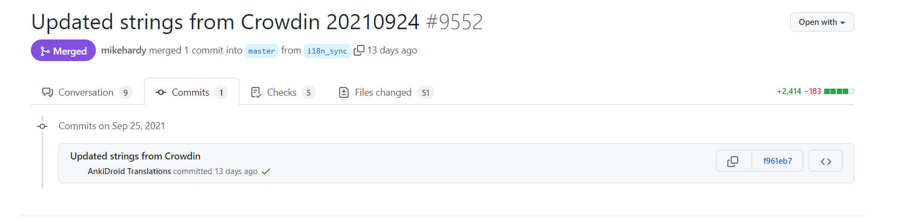
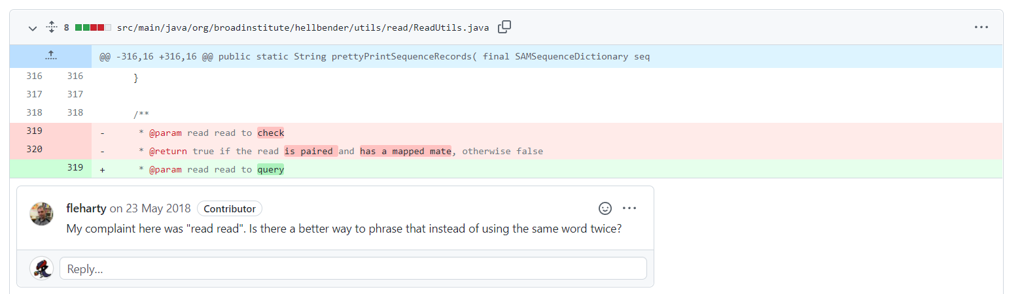
Commits in PR
Each PR can only get 250 commits at most due to the limitation of Github
101,020 commits in total
Comments in commit

Slide 13
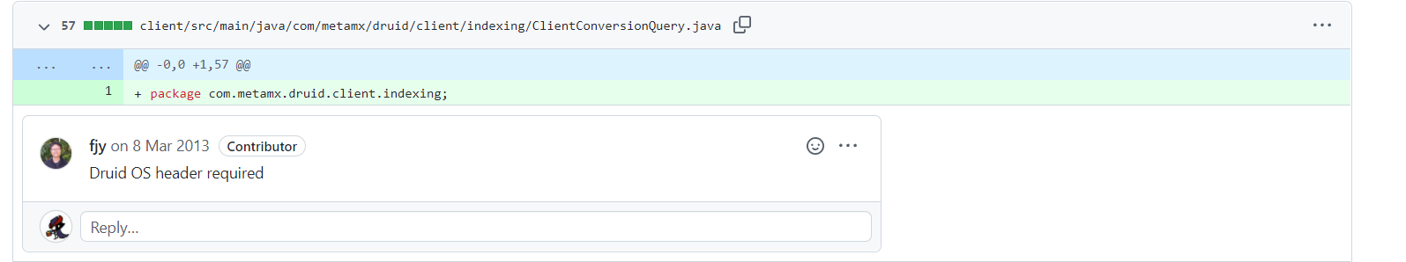
User
Creation date
Update date
Author association
Commit id
File path
line number(comment)
……

Slide 14
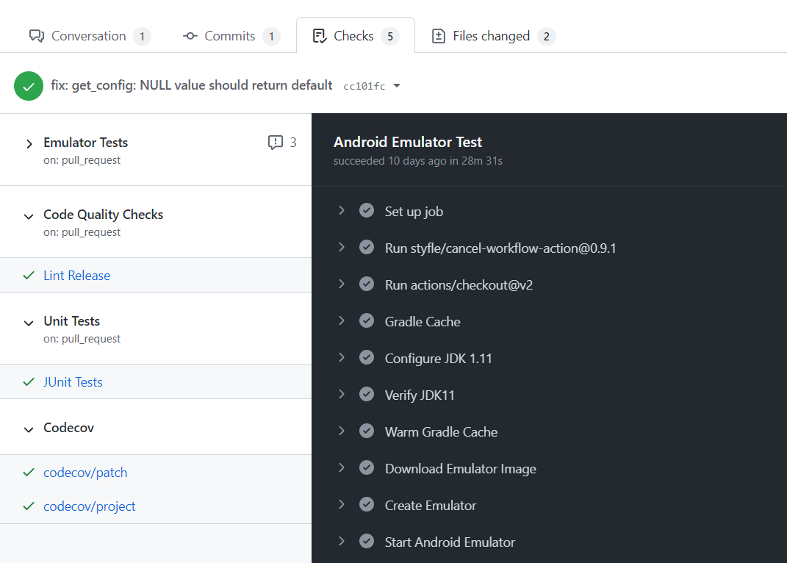
Checks
Check run and check suit can be collected using github api
Did not finish collection, because my account was suspended

Slide 15
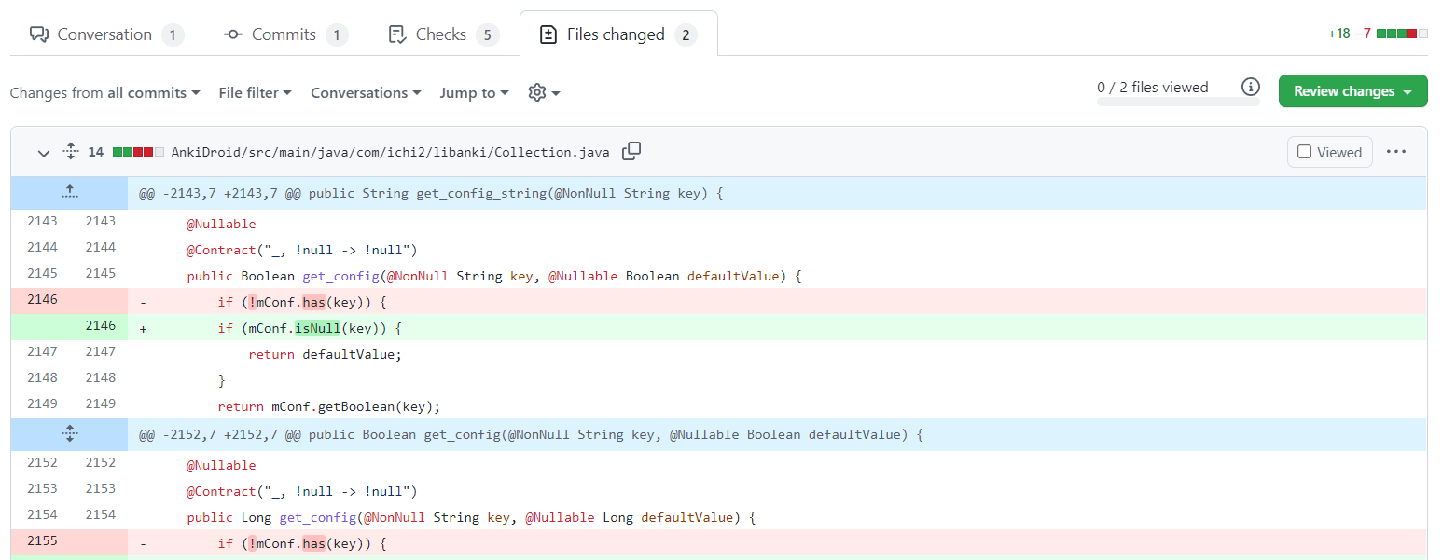
Files changed in pull request
File name
Additions
Commit id
Deletions
Changes
……

Slide 16
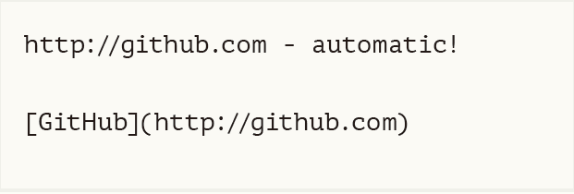
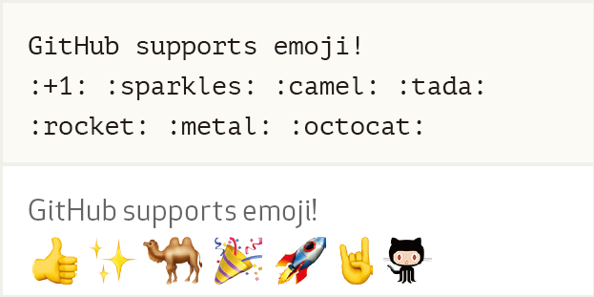
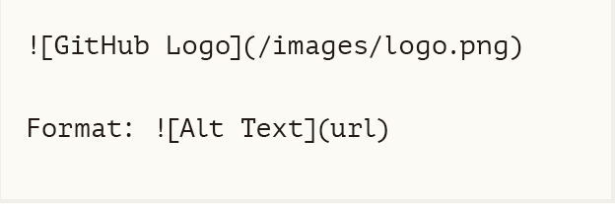
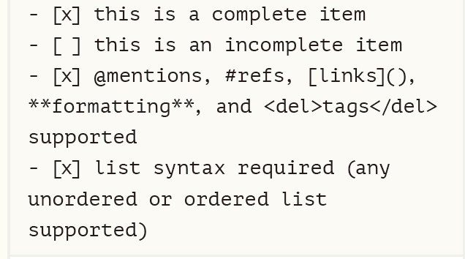
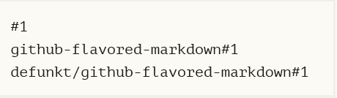
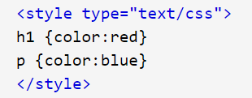
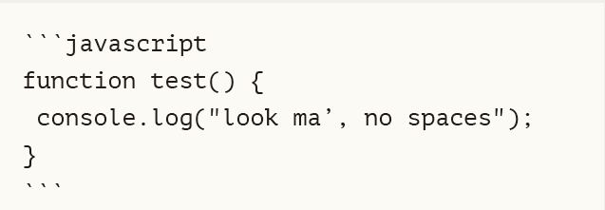
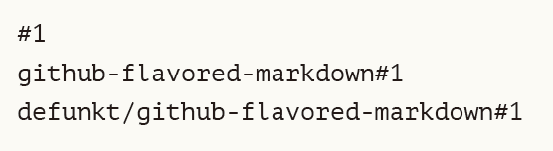

Data Cleaning
Examples of non-natural-language items that need to be removed
Images
Links
Emoji
Issue references
Tasks lists
Html tags
ISSUE REFERENCES
Code block

Slide 17
continue
Branch name: Merge branch xxx into xxx, Merge branch xxx……
File: src/com/Ankidroid.java……
Url: http://example.com ……
Path: src/com……
USERNAME: @MENTIONS……
Package: com.coalmine.management……
Comment in html: <!-- -->
Others: Commit id, punctuation, digit, blank,<xxx> ……
Codes in code comments are removed manually

Slide 18
Preprocessing
Remove words less than three characters
Remove stop words
Spelling check
Lemmatization
Remove words less than three characters again
Remove stop words again
Remove none English words

Slide 19
Identify Self-Admitted Technical Debts
SATD | Non-SATD
3,250 | 32,679
Use public SATD dataset to train classification model
Data cleaning for dataset (urls, html tags, punctuation……)
Remove duplicate samples from dataset
Deal with dataset imbalances
Sample from Non-SATD 10 times to build 10 pcs of balanced datasets with SATD
Train 10 Maximum Entropy Models separately
Use these models to predict code comments separately and use the most frequent label as result
model | precision | recall | F1-score
1 | 0.750 | 0.962 | 0.843
2 | 0.764 | 0.958 | 0.850
3 | 0.761 | 0.959 | 0.848
4 | 0.771 | 0.957 | 0.854
5 | 0.768 | 0.958 | 0.853
6 | 0.762 | 0.961 | 0.850
7 | 0.778 | 0.956 | 0.857
8 | 0.765 | 0.954 | 0.849
9 | 0.771 | 0.947 | 0.850
10 | 0.764 | 0.961 | 0.851

Slide 20
Label Self-Admitted Technical Debts Manually
17,729 code comments in code clone
5,398 code comments are labeled as SATD(predicted by our models)
Relabel all code comments labeled as SATD
All code comments contain “todo”, “fixme” and “xxx” will be labeled as SATD
740 code comments are labeled as SATD(it will be more accurate if several people label these code comments and do Kappa test)

Slide 21
Track history of SATD
Get commit that SATD was introduced
Use Git to track the history of file that contain SATD
git log -M90% -p --follow -- filepath
Check SATD was introduced in which commit
Get commit that SATD was deleted
Find all branches that contain commits of SATD
Get logs of commits in each branch
Get all codes that were removed
Check if SATD was removed
Get the commit that SATD was removed
Get the file where SATD is in
Track the history of that file and check if that file is the descendant of code clones
Get the author of the commit and the date when it was submitted
Notes: it will be more accurate to use “git blame” to track the history of codes of every lines

Slide 22
Example
In project checkstyle
There are 272 SATDs in total
172 SATDs are removed
28 SATDs are removed by author himself
On average it takes 1,018 days to remove a SATD and median is 544 days

Slide 23
Thanks!

